Slide 1
Simplified Inundation Maps for Dam Break Emergency Action Planning
Robert Hines
Sponsored by the Center for undergraduate Research opportunities and the Carl Vinson Institute of government

Slide 2
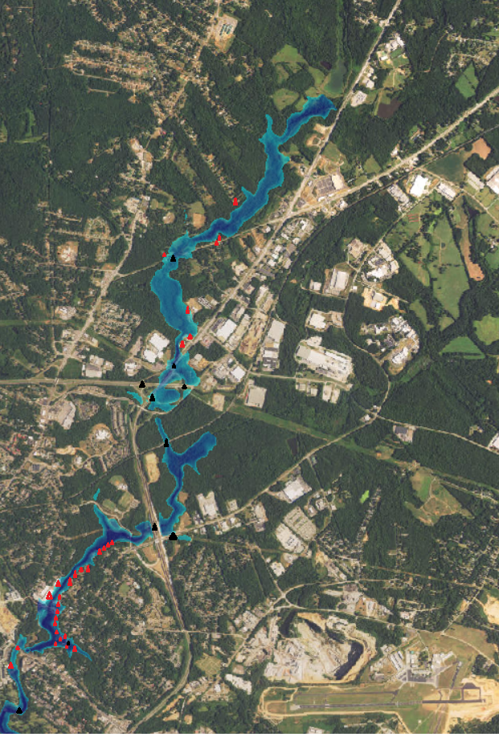
What is a simplified inundation map?
Assumes a failure scenario
Estimates the dam breach flow
Routes the flood wave down a digital map
Produces a snapshot of the flooded area
Identifies areas at risk ~ this map highlights flooded roads and buildings

Slide 3
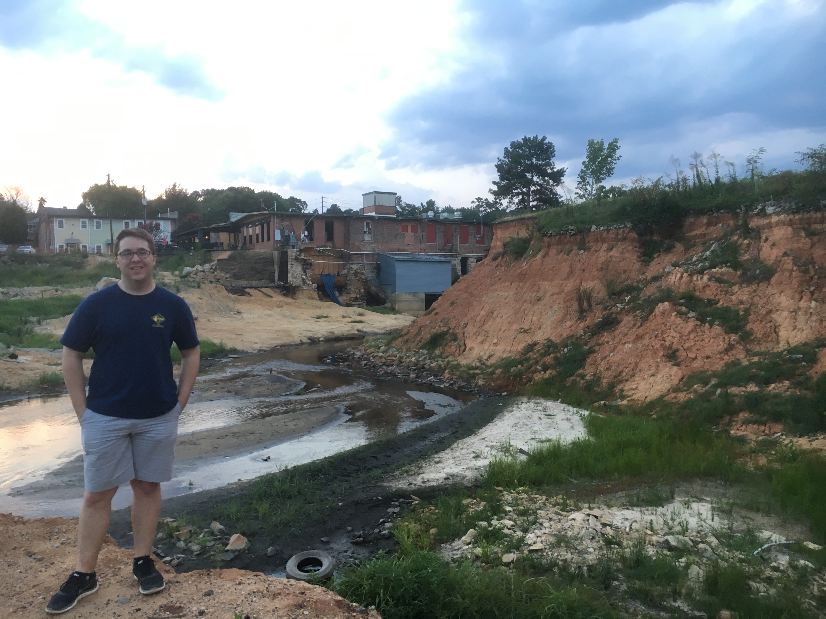

The Need for Simplified Inundation Maps in Emergency Action Planning
Emergency Action Plans will be required for all category one dams in Georgi$a^{1}$
EAP’s should contain six elements: a notification flowchart, a response process, responsibilities, preparedness activities, and an inundation ma$p^{2}$.
The inundation map primarily informs evacuation notices and response procedures. Safety measure around the perimeter of the affected areas and re-entry procedures are determined by the inundation map.
1 – Environmental Protection Division, 2016
2- Federal Emergency Management Agency, 2013

Slide 4
Department of Homeland Security DSS WISE LITE
Web based platform that pulls data from national inventory of dams and automatically produces inundation map.
Pros | Cons
No required delineation | Currently offline with plans to revive the service coming
User friendly experience | High potential for inaccuracies
Brian Cook, 2015
Federal Emergency Management Agency, July 2013
Kentucky Divison of Water

Slide 5
Federal Emergency Management Agency: GeoDam BREACH
Integrated software into ArcGIS that produces EAP’s
Uses dimensionless routing graphs to route time to peak at downstream locations
Pros | Cons
Minimal required delineation | Requires ArcGIS with 3-D Analyst and Spatial Analyst
Simplification reduces potential for user error | Simplification increases chance of inaccuracies
Integrates EAP production into mapping experience
Brian Cook, 2015
Federal Emergency Management Agency, July 2013
Kentucky Divison of Water

Slide 6
Army Corps of Engineers: HEC RAS – steady state
ArcGIS extension that imports a file into independent HEC RAS application
The steady state HEC RAS model uses the continuity equation, energy equation, and flow resistance equation to route the flood wave.
Pros | Cons
Accurate model | Requires a great deal of delineation
Geometric data can be used to create increasingly complicated models | Relatively high potential for user error
Version 5.1 and QGIS may allow the software to be completely free | Currently requires ArcGIS with 3-D Analyst enabled at a minimum
Abt, S., Kasper, K., Robenson, M., Thornton, C., and Watson, C, 2005
Federal Emergency Management Agency, July 2013
Kentucky Divison of Water

Slide 7
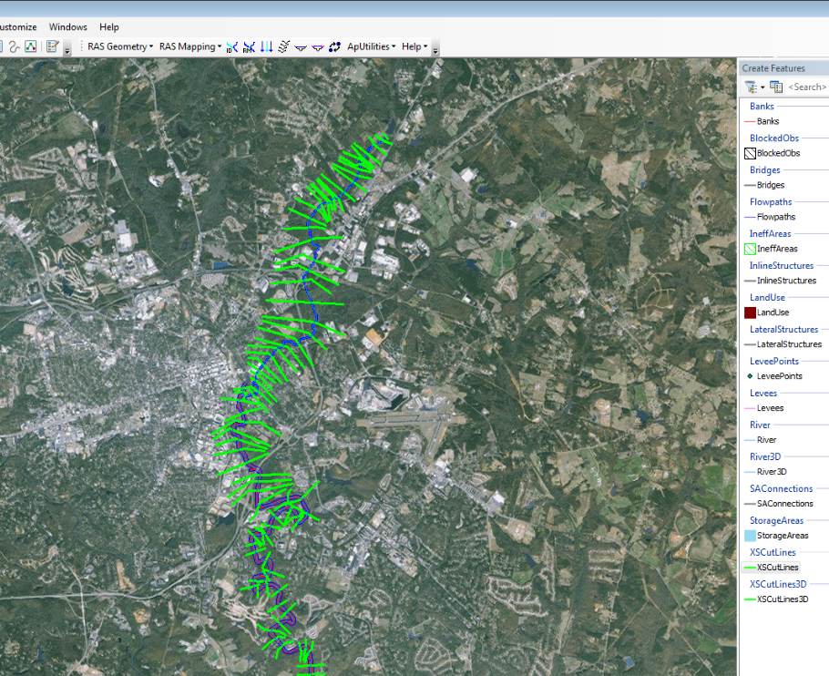
Guide to HEC RAS Steady State
Currently working on guide to simplified inundation mapping with HEC RAS under the steady state model
Initial guide and case study drafted – I’ve brought copies for interested individuals

Slide 8
References
Abt, S., Kasper, K., Robenson, M., Thornton, C., and Watson, C. (2005). Accuracy of HEC-RAS to Calculate Flow Depths and Total Energy Loss with and Without Bendway Weirs in a Meander Bend (Prepared for US Department of the Interior Bureau of Reclamation). Fort Collins, Colorado: Colorado State Unviersity, Engineering Research Center.
Cook, Brian. (2015) National Dam Safety Program Technical Seminar No. 22 Dam Breach Modeling and Consequence Assessment (.pdf slides). Retrieved from http://www.damsafety.org/media/Documents/FEMA/TS22_DambreachModeling/18_PRESENTATION.pdf
Environmental Protection Division. (August 2016). Proposed Amendments to Rules for Dam Safety, Chapter 391 3- 8. Retrieved from https://epd.georgia.gov/sites/epd.georgia.gov/files/Synopsis%20of%20Proposed%20 Amendments%20to%20Rule%20Chapter%20391 -38%20and%20Statement%20of%20Rationale%20%282 %29.pdf
Federal Emergency Management Agency. (July 2013). Federal Guidelines for Dam Safety (FEMA 34). Retrieved from http://www.fema.gov/media-librarydata/5b20db599c212f77fd5e85d256f471a3/EAP%20Federal% 20Guidelines_FEMA%20 P-64.pdf
Federal Emergency Management Agency. (July 2013). Federal Guidelines for Inundation Maping of Flood Risks Associated with Dam Incidents and Failures (FEMA P-946). Retrieved from https://www.fema.gov/media-library/assets/documents/34193
Kentucky Divison of Water (n.d.) Dambreach Modeling. Retrieved from http://www.damsafety.org/media/Documents/FEMA/TS22_DambreachModeling/18_PA PER.pdf

